Slide 1
IS 3020 Project Presentation :
Guess the Number
Game
Members (solo) : Lucio Almaraz Jose

Slide 2
1
Table Of Contents
1
2
3
Introduction
Demonstration
And Screenshots
References

Slide 3

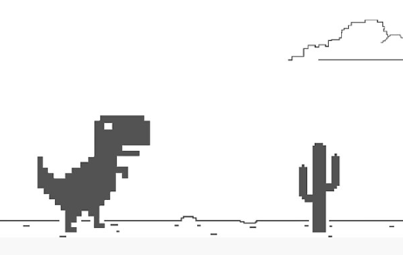
Introduction
What is a Number Guessing Game
“Guess the number” is a game where the player(you) think of a number in a certain range, and the player need to guess the correct number.
Format of the Game:
The game sets a range of numbers (0-100)
The player guess a number in certain range and the game gives feedback like,” a bit higher” or “a bit lower”
Objective goal of this game is guess the correct number in as limit attempts possible.
Purpose/Idea of creating this game project
I got the Idea of creating this game project is coming from Chromes T-rex runner whenever the Wifi goes out and your on chrome, this game shows up. I thought what if I create a non-wifi game for people who are bored in wifi crash or bored of doing nothing

Slide 4
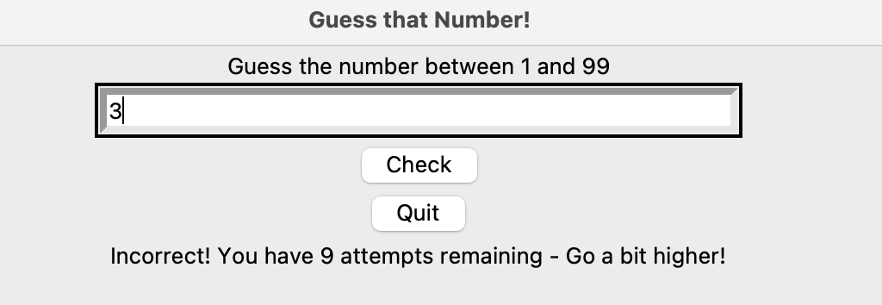
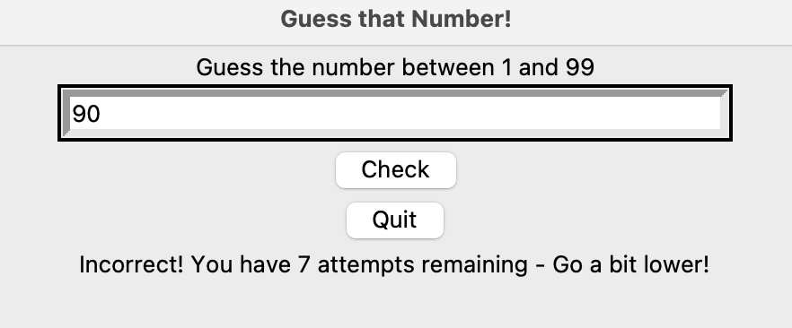
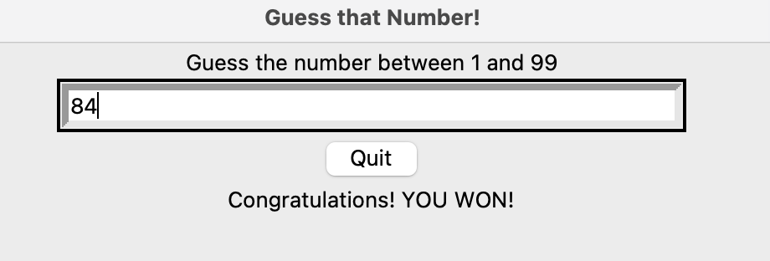
Demonstration & screenshots

Slide 5
References
My GITHUB link:
https://github.com/ksu-is/Guess-the-Number
Inspirations games and respretories
https://github.com/techwithtim/Number-Guesser-Neural-Net
https://trex-runner.com/

